Slide 1
Data
A Rude Introduction

Slide 2
Definitions of Data
Factual information (as measurements or statistics) used as a basis for reasoning, discussion, or calculation.
Information output by a sensing device or organ that includes both useful and irrelevant or redundant information and must be processed to be meaningful
Information in numerical form that can be digitally transmitted or processed.
Factual information, especially information organized for analysis or used to reason or make decisions.

Slide 3
Some Famous Philosophers of Data and Knowledge
Data is a precious thing and will last longer than the systems themselves. Tim Berners-Lee
Experts often possess more data than judgment. Colin Powell
Biographical data, even those recorded in the public registers, are the most private things one has, and to declare them openly is rather like facing a psychoanalyst. Italo Calvino
Data is not information, information is not knowledge, knowledge is not understanding, understanding is not wisdom. Clifford Stoll Data is what distinguishes the dilettante from the artist. George V. Higgins
Facts are meaningless. You could use facts to prove anything that's even remotely true!
Home Simpson

Slide 4
How Data Fits In
Theory
The Scientific Method!!!
Hypothesis
Analysis
Prediction(s)
Test
(Experiment)

Slide 5
How Data Fits In
Data
Theory
The Scientific Method!!!

Slide 6
How Data Fits In
Data
Theory
The Scientific Method!!!
Hypothesis
Analysis
Prediction(s)
Test
(Experiment)
Data

Slide 7
So What Does This Mean To Us?
The is no answer right?
Is there a end to the scientific method?
Why is it useful?
Can we set policy?

Slide 8
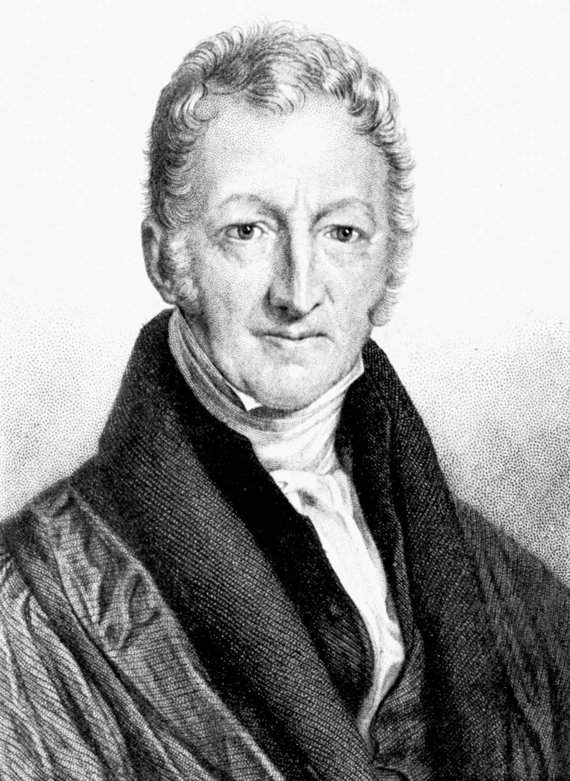
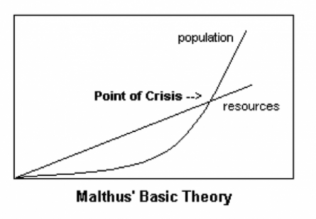
Thomas Malthus – Theory of Scarcity

Slide 9
How We Ask Questions
Women Water and Work
Water is scarce.
Women often suffer from inequality.
Water is not evenly or fairly distributed.
Can we solve the water issue by solving inequality issues?
Can we solve inequality issues by solving water issues?

Slide 10
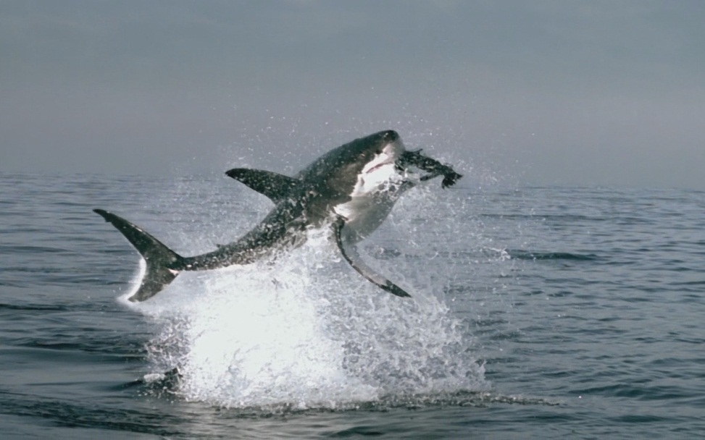

What’s more dangerous at the Beach?
"Falling coconuts kill 150 people worldwide each year, 15 times the number of fatalities attributable to sharks."
http://www.shark.org.au/quotes.html
http://www.straightdope.com/columns/read/2405/are-150-people-killed-each-year-by-falling-coconuts

Slide 11
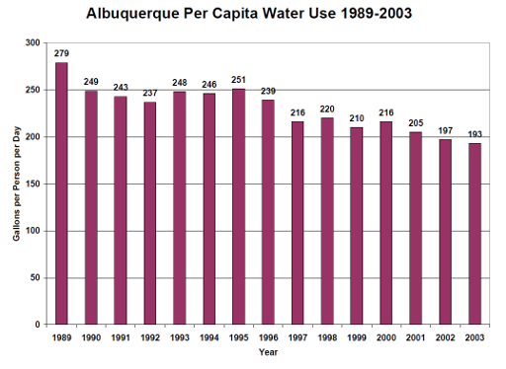
Good News

Slide 12
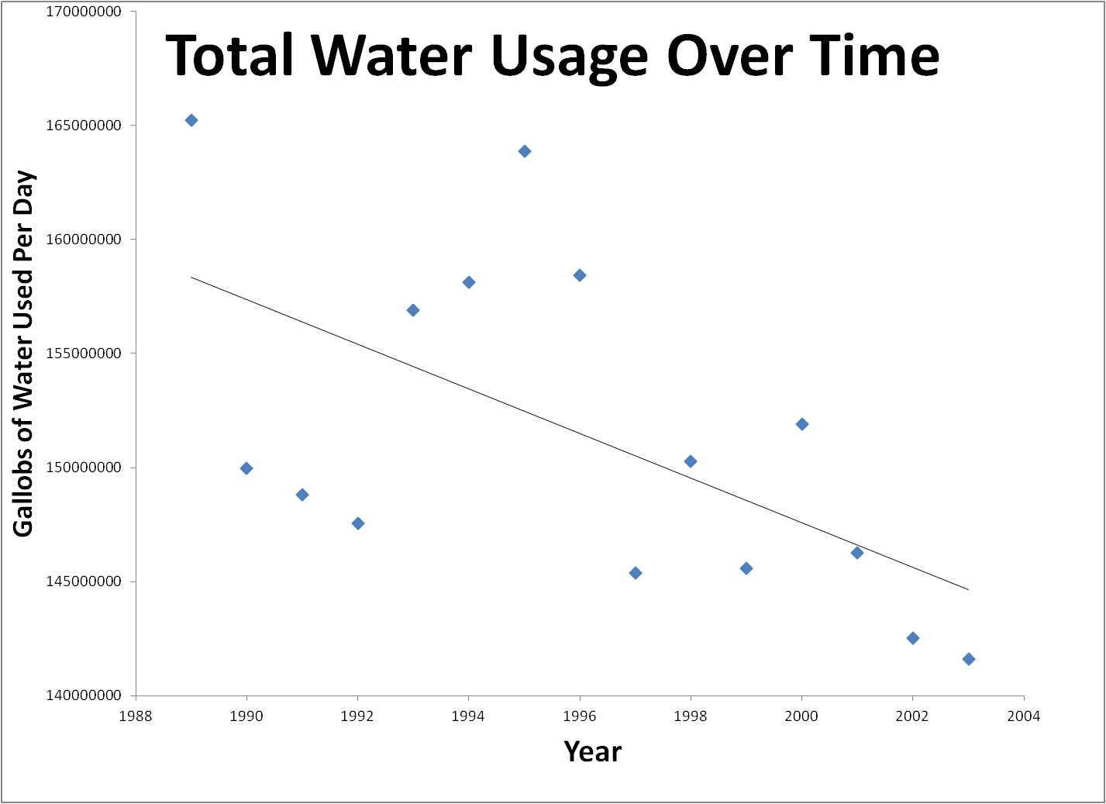
WOW!

Slide 13
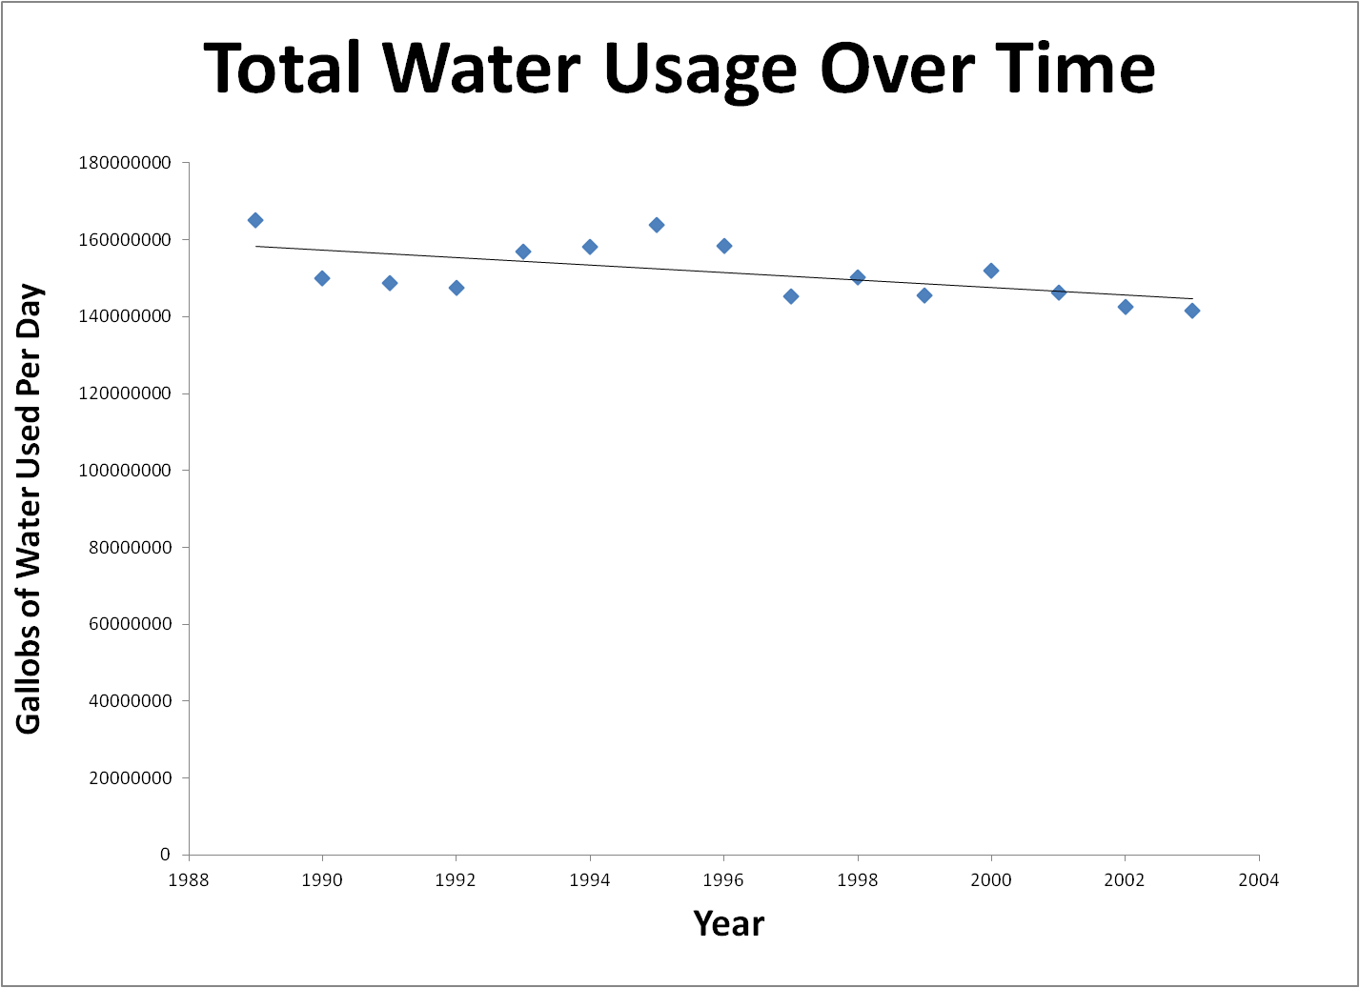
WOW?

Slide 14
Assignment!
Work through the ADVANCED WATER FOOTPRINT calculator.
Write an essay (1-2 pages) about it.
Strengths
Weaknesses
Assumptions
Points awarded for pissing me off in an intelligent way.

